Slide 1
6th Generation Of Intel's Processors
Oluwatobiloba Situ
6864609
CEG4136- PROF. M. BOLICH

Slide 2
Objective
To discuss some of the newest advances in this series of processors with regards to:
Power Management
Architecture

Slide 3
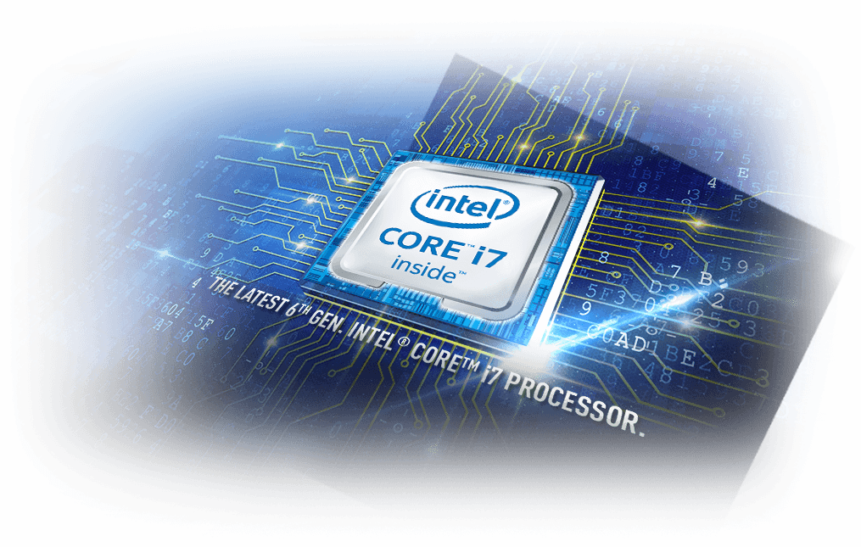
Intel Core ?
Intel Core- CPU’s sold by Intel Corporation.

Slide 4
6th Generation Processors
AKA Skylake
Some Features:
Pipeline bandwidth of 5µ-operations per cycle
Supports Hyper-Threading Technology
Intel Speed Shift Technology
Duty Cycling

Slide 5


What does all that mean??

Slide 6
Power Management
Clients want:
systems that are functional, and
devices with better battery lives

Slide 7
Power Management
Considering all the Intel processors that existed up until the 67 series processors, the 67 series are said to have the largest dynamic power range [4.5W - 90W]
in passive, cooled small systems
in high- performance desktop computers

Slide 8
Intel Speed Shift Technology
Answer:
Processor performance states (P-states) & processor operating states (C-states) are the capability of a processor to switch between different supported operating frequencies and voltages to modulate power consumption
Question:
Does anyone know what P-state or C-state stand for?

Slide 9
Intel Speed Shift Technology
What does it do?
The OS hands over some/all control of the P-states to the Processor.
It is faster for the Processor to boost or decrease the frequency, compared to the OS.
Prior to this new technology, the OS handled power management.
CPU response time with old Technology | CPU response time with new Speed Shift Technology
20-30ms to inform OS about something (e.g: workload has increased) and for the OS to respond. | 1ms.

Slide 10
Question
frequency =
processor's performance.
or

Slide 11
Answer
frequency = processor's performance.

Slide 12
When the processor is operating at its highest guaranteed frequency (P1), the frequency is temporarily boosted (P0 state) by the processor.
frequency = processor's performance.
And when the processor is operating below P1 (P2,P3,...) , power management is done by the OS.

Slide 13
frequency =
frequency = power consumption.
processor's performance and easily handle workload.
CPU response time with old Technology | CPU response time with new Speed Shift Technology
20-30ms to inform OS about something (e.g: workload has increased) and for the OS to respond. | 1ms. Therefore, processor is quick to react and quick to cut the frequency.

Slide 14
Duty Cycling
At low frequencies, the lowest possible P-state is calculated.
Power ~ Frequency³
∴ cutting the frequency is essential to save energy.

Slide 15
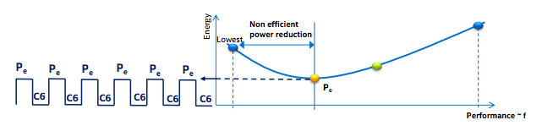
Duty Cycling
P_{e} : Most efficient Energy calculated every ms.
C6: Power state available as a power saving measure

Slide 16
Duty Cycling
At low frequencies, the lowest possible P-state is calculated (P-state: a frequency and operating point).
Once it reaches its most efficient frequency, it cycles between the P_{e} and C6. (P_{e} calculated every ms).
Less energy is consumed because the processor chooses the most optimum performance level for a given task.
Power ~ Frequency³
∴ cutting the frequency is essential to save energy.

Slide 17
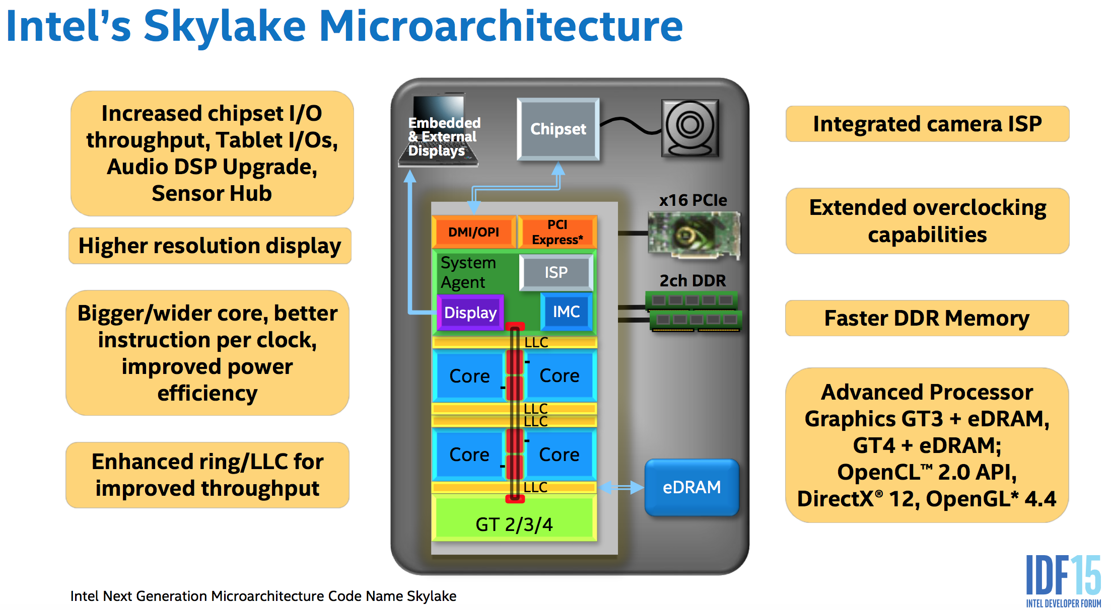
Intel’s Skylake Microarchitecture- SOC design

Slide 18
Intel’s Skylake Microarchitecture
Core is a bit wider so it can dispatch more instructions at once
Higher IPC
Higher frequency
Higher dynamic power range
reduced penalties
branch misprediction (19 to 14)
mispredicted direct jump
Updated Instruction prefetch
reduces cache miss penalties
Legacy decode Pipeline bandwidth now 5 µ-OPS per cycle
CLFLUSHOPT faster instruction to flush cache lines.

Slide 19
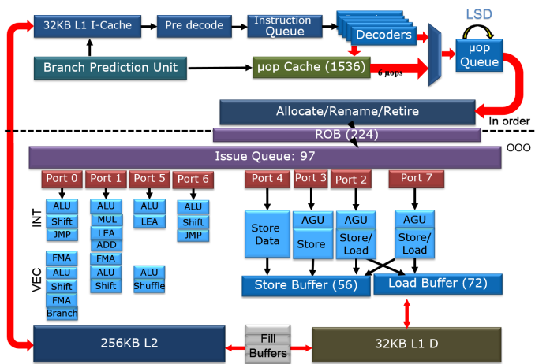
Skylake core block diagram

Slide 20
Conclusion
Researching this topic showed the designers of these processors aimed towards the computer Architecture principles that we currently study /are yet to study in this course such as-
reducing miss penalty,
increasing frequency
and reducing power consumption.

Slide 21
Additional questions:
Question
In the microarchitecture diagram, there was a feature mentioned: “extended overclocking capabilities” What does overclocking mean ?
Answer:
Overclocking: setting your CPU and memory to run at speeds higher than their official speedgrade.

Slide 22
Additional questions:
Question
What is the usefulness of the “branch prediction unit” ?
Answer:
It improves the flow in the instruction pipeline by trying to guess or predict which way a branch will go.
(branch: if-else)

Slide 23
Additional questions:
Question
Why does the L2 cache not have separate I/D caches like the L1 cache ?
Answer:
Most CPUs nowadays have a unified L2 cache which holds both code and data. The reason for this is that having separate L2I and L2D caches would pointlessly consume the transistor budget while failing to deliver any measurable performance gains.

Slide 24
References
[1]"Intel Skylake Architecture Preview Quick Take From IDF 2015 | HotHardware", Hothardware.com, 2017. [Online]. Available: https://hothardware.com/reviews/intel-skylake-architecture-preview-quick-take-from-idf-2015. [Accessed: 15- Sep- 2017].
[2]2017. [Online]. Available: https://en.wikichip.org/w/images/8/83/Intel_Architecture,_Code_Name_Skylake_Deep_Dive-_A_New_Architecture_to_Manage_Power_Performance_and_Energy_Efficiency.pdf. [Accessed: 15- Sep- 2017].
[3]J. Doweck, W. Kao, A. Lu, J. Mandelblat, A. Rahatekar, L. Rappoport, E. Rotem, A. Yasin and A. Yoaz, "Inside 6th-Generation Intel Core: New Microarchitecture Code-Named Skylake", IEEE Micro, vol. 37, no. 2, pp. 52-62, 2017.
[4]"6th Generation Intel® Core™ Processor Family Datasheet, Vol. 1", Intel, 2017. [Online]. Available: https://www.intel.com/content/www/us/en/processors/core/desktop-6th-gen-core-family-datasheet-vol-1.html. [Accessed: 15- Sep- 2017].

Slide 25
Thanks for listening!

